Slide 1
Software Process and Quality Management
Team Assignment 03
Case Study 2: FibreNet Project

Slide 2



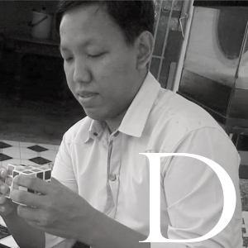

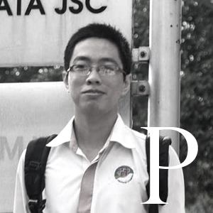
MEET THE TEAM
BigFive
®
K16T1

Slide 3

Session Agenda
Background
How were they used?
Conclusion
Aspects of the models

Slide 4

Background
Thu Nguyen

Slide 5
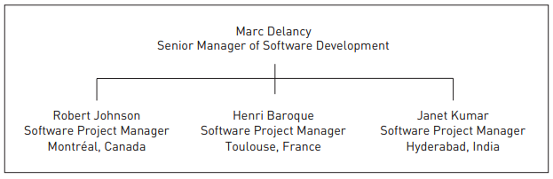
CHARACTERS

Slide 6
EVENT
No | Events |  | Description
1 | Choose the way to develop product | Marc Delancy | Decision to locate the company’s development sites in strategic but geographically dispersed places to, over time, achieve substantial reductions in development cost and time.
2 | Marc is hearing the same comments from his project managers repeatedly
3 | Realizes that there is a recurring pattern to what is being said and how it is being said | Marc Delancy | The time of teleconference is not fitted for all teams.
4 | Marc realizes that other than these weekly teleconferences, the three managers probably have minimal communication with each other. | Marc Delancy
Contd…

Slide 7
EVENT
No | Events |  | Description
5 | He had decided on traveling to the Hyderabad and Montréal sites every three months | Marc Delancy | In-Person Meetings with the Project Managers: When planning his travel budget for the project, he had decided on traveling to the Hyderabad and Montréal sites every three months. Over the eighteen-month project, he would take six trips to each of these sites.
6 | The first three months of the project is the time to communicate in person and in private with the project managers at each site | Marc Delancy | The first three months of the project have passed: Considering the current state of communications between the software managers, Marc decides that this is the time to communicate in person and in private with the project managers at each site. He wants the project managers to feel comfortable in talking candidly.
Contd…

Slide 8
EVENT
No | Events |  | Description
7 | Marc travels to India to talk with the Hyderabad team members | Marc Delancy | On to India After his meeting with Henri, Marc travels to India to talk with the Hyderabad team members. The team members are very interested in what Marc has to say about the development of the QoS policies and user interface layer in Toulouse. They are also eager to show him the design for the architecture of the business layer that they have been drafting.
8 | Marc has some ideas about why his team is having problems with communications and collaboration. | Marc Delancy | After his meeting with Janet: Marc has some ideas about why his team is having problems with communications and collaboration. He hypothesizes that there are issues involving trust among the different sites. Hyderabad is in the middle because the software being developed there must interface with software being developed at both Toulouse and Montréal
Contd…

Slide 9
How were they used?
Phu Ta –Dao Khau

Slide 10
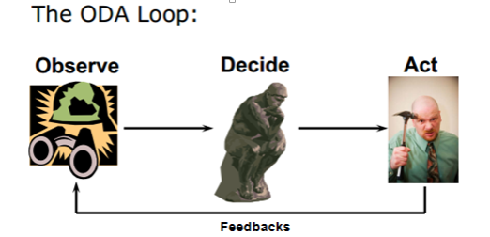
Notes:
Nhóm nghiên cứu đánh giá các dữ liệu thu thập trong giai đoạn measure. Họ phân tích cả dữ liệu và quy trình trong một nỗ lực để thu hẹp và xác minh nguyên nhân gốc rễ lảng phí và các defects.
Kiểm tra chặt chẽ quy trình
hiển thị dữ liệu trực quan
Brainstorm nguyên nhân tiềm năng của vấn đề
Xác minh nguyên nhân gây ra của vấn đề
Cập nhật project charter

Slide 11
Observe
Marc realizes that the tasks involving collaboration between the sites are behind schedule while those that can be done solely within the local sites are on schedule
Marc find out that global communications and collaboration across the three development sites are not happening
Marc realizes that other than these weekly teleconferences, the three managers probably have minimal communication with each other.
The three sites are obviously not collaborating on the design of the interfaces to the different layers of the Network Manager.

Slide 12
Observe
Because of geography distance, three project managers discussed via teleconference. It is difficult to everyone could express their comment and opinion about topic.
Marc thinks that the start of the meeting the times in the different locations were 8 a.m. in Montréal, 2 p.m. in Toulouse, and 5:30 p.m. in Hyderabad. The times roughly correspond to the start and end of the working day as well as the time directly after lunch for the participants. This may be why everyone seemed sluggish.

Slide 13
Decide
Marc plans his travel budget for the project, he had decided on traveling to the Hyderabad and Montréal sites every three months. Over the eighteen-month project, he would take six trips to each of these sites.
Considering the current state of communications between the software managers, Marc decides that this is the time to communicate in per-son and in private with the project managers at each site.

Slide 14
Action
Event | Source of feedback | Content
Marc met Henri in France | Henri Baroque | Henri reflects Janet team that didn’t collaborated. He didn’t satisfy with attitude’s Janet team:
Marc met Janet team members in India | Janet Kumar | Janet reflect her team moderate not good. She also didn’t satisfy with attitude’s other team:
Marc back in Robert’s office | Robert | Robert reported that the description of the algorithms is not yet complete:

Slide 15
Re-observe
Factor (Marc’s Notes) | Questions
Trust (very influential) | How well do the team members trust that their colleagues can and will complete their project deliverables according to the quality specifications? How does the grouping of team members into distinct clusters affect the trust shown across the whole team? How else does trust impact collaboration across the team?
Cultural differences (influential) | How do the development sites differ in the following aspects that affect collaboration and coordination? Styles of communication Approaches to collective problem solving Approaches to making group decisions Communications with people at different levels of responsibility within the team and across the various locations

Slide 16
Time separation (influential) | How does the difference in time zones affect the ability of the team members to communicate? In what ways does the difference in time zones support productivity through opportunities for the team to work around the clock?
Communication protocols (not established) | What guidelines are established for communicating across globally distributed teams? What practical help do the guidelines provide for resolving problems that involve issues such as courteous language and timely communication?
Planning for collaboration (probably not adequate) | How well does the task breakdown & schedule do the following: Promote working in parallel and around the clock? Clarify the tasks and information that will need to be coordinated within given time frames? What understanding do the project members (and project managers) have about the way in which they need to collaborate to develop and deliver project deliverables on time and within budget? What plans do the project managers have for ensuring the necessary communication and collaboration?

Slide 17
Re-decide
Marc reflects that they had spent little time discussing issues related specifically to the management of global software development. They had made the following decisions regarding communications across the distributed team. Prior decisions regarding communications:
Communications would be in English.
The communication technologies would be Internet-based: e-mail, video conferencing, VoIP, and instant messaging.
A central repository for sharing documents, code, and other software artifacts would be located at the Montréal site. The repository would support configuration control.
The project managers would have Web cameras on their desks and use headsets. Each site would have a meeting room equipped with videoconferencing equipment for group discussions with the other sites.

Slide 18
Conclusion

Slide 19
#ID | Issue | Improvement | How to Use | Conclusion
1 | Communication channel is not good between site because different location. | Communications would be in English, e-mail, video conferencing, VoIP | Require all site discuss in teleconference by English The communication technologies would be Internet-based: e-mail, video conferencing, VoIP, and instant messaging | For everyone could express their comment and opinion about topic.
2 | Lack of collaboration with each other in the transfer of material | Configuration Management. | A central repository for sharing documents, code, and other software artifacts would be located at the Montréal site. The repository would support configuration control. | For all sites to capture the work status and avoid having to wait the work of the other.
Contd…

Slide 20
#ID | Issue | Improvement | How to Use | Conclusion
3 | Meeting time via teleconference software is not unreasonable | Find a reasonable time for meeting. | The project managers would have Web cameras on their desks and use headsets. Each site would have a meeting room equipped with videoconferencing equipment for group discussions with the other sites. | To create psychological comfort for three managers discuss in an effective way.
4 | This site are not satisfied with work attitude of the other site | Work attitude. | Marc should create meetings periodically for three managers talking candidly about work attitude of the other and then solve their problems. | To improve the attitude of cooperation between sites.

Slide 21
Aspects of the models
Khang Huynh

Slide 22
V-Model: Requirement Engineering, architecture and design, implementation, and testing
CMMI: Project Planning, Project monitoring and control, Verification using simulation and review, Configuration Management.

Slide 23
Recommend
Applying Risk Management
Applying Process management
Applying Integrated project management + IPPD

Slide 24
Q & A

